Slide 1
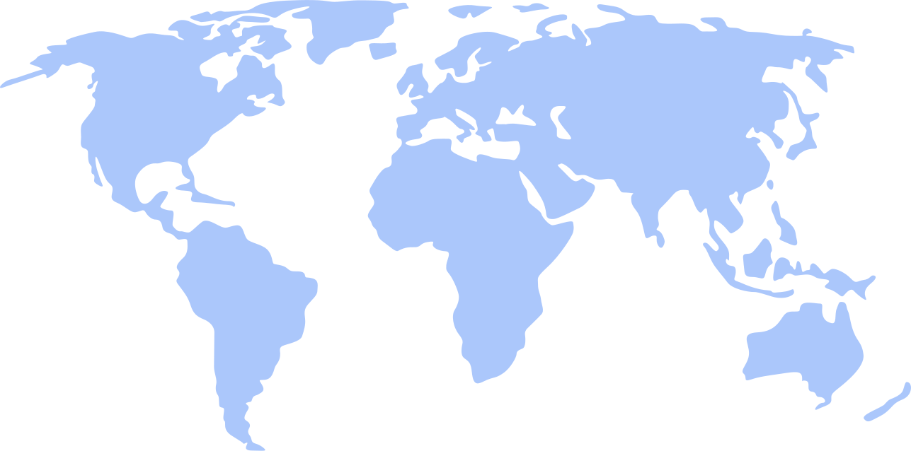

ETZ - GDP
Data Science presentation by:
Eytan Rahlin
Tony Hasson
Ziv Simchoni

Slide 2



LETS MEET
OUR TEAM MEMBER
Ziv simchoni
Tony Hasson
Eytan rahlin
Leading Developer
Leading Developer
Leading Developer
Technology enthusiast and a passionate learner with a keen interest in Python and Android ROMs.
A software dev with the goal of achieving expertise in Python, Data analyzing & management.
Outgoing and responsible with a strong passion for programming. Unique problem solving approach.

Slide 3



WHAT IS GDP?
Gross domestic product (GDP) is the monetary value of all finished goods and services made within a country during a specific period.
GDP provides an economic snapshot of a country, used to estimate the size of an economy and growth rate.
GDP is a key tool to guide policy-makers, investors, and businesses in strategic decision-making.

Slide 4
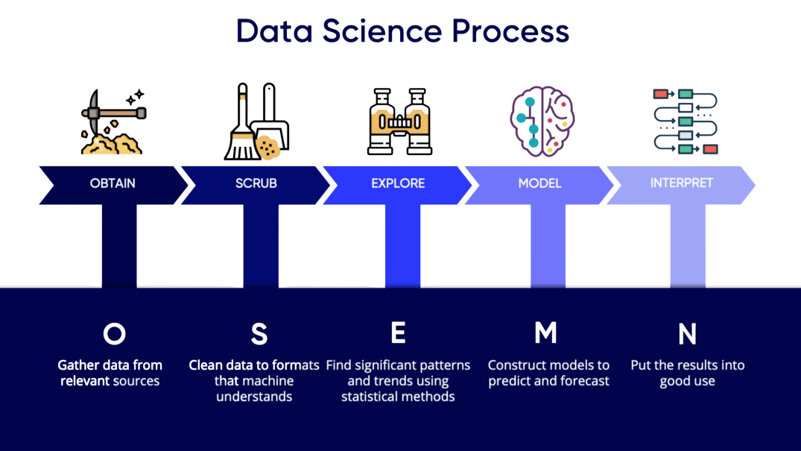

Slide 5

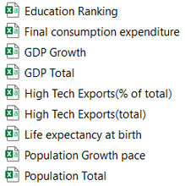
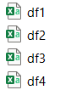

OBTAIN THE DATA
Scraping: Wikipedia.org, Numbeo.com, OurWorldInData.org, Burningcompass.com
CSVs: data.worldbank.org
Step
01
We've scraped the relevant data and built a CSV from every resource.
02
We've realized that we cannot combine all the CSVs into one database thats because the combined DB would have too much missing data - due to not overlapping years.
03
We decided to build a separate CSV for the scraping and for the downloaded data.
It was much easier to use two different CSV's as our main data points.
"df_Full_DataBase" contains all data from 1960 through 2020
"df_Scrape" contains all data from 2009 through 2020
What data have we gathered?
Various GDP information, Indexes growth rate, Population Data, Cost of living and spending per country.
Have we encountered data duplications?
Yes, we had a few countries that appeared more than once but with a different name.

Slide 7
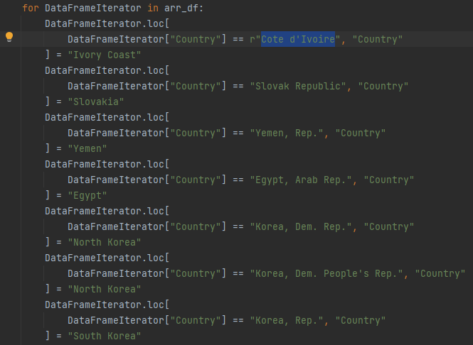

DATA
Country names
The data is distributed between the 2 CSV's:
df_scrape: Cols: 20 X Rows: 1637 = 38,740
df_Full_DataBase: Cols: 16 X Rows: 10432 = 166,912
Total data points: 205,652
We noticed some countries have a lot of missing data, although the data is found in the databases.
After EDA we realized that different databases write the country names differently, see Ex.1.
Missing Values
We've noticed there is too much missing data, hence we decided to use linear regression to complete the missing values.
Ex.1

Slide 8
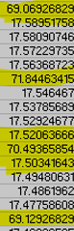
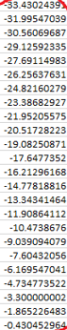
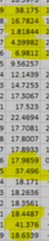
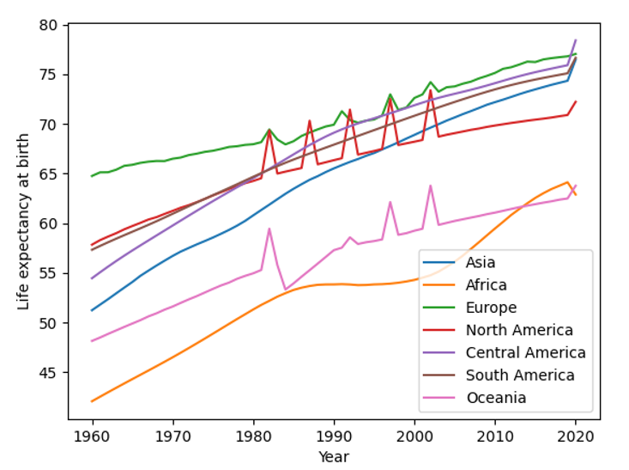
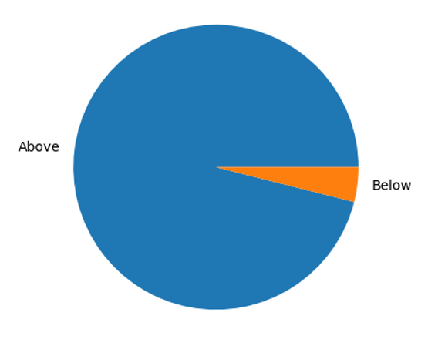
HOW HAVE WE DEALT WITH OUTLIERS?
We found out about a few outlier countries by viewing anomalies when plotting graphs.
Afterwards, we realized that many countries with population under 100k have missing/not much/false data.
palau
tuvalu
nauru
In conclusion, we have decided to delete all the countries with population under 100k, and thus we have dealt with a major amount of data anomalies.
100K
100K

Slide 10
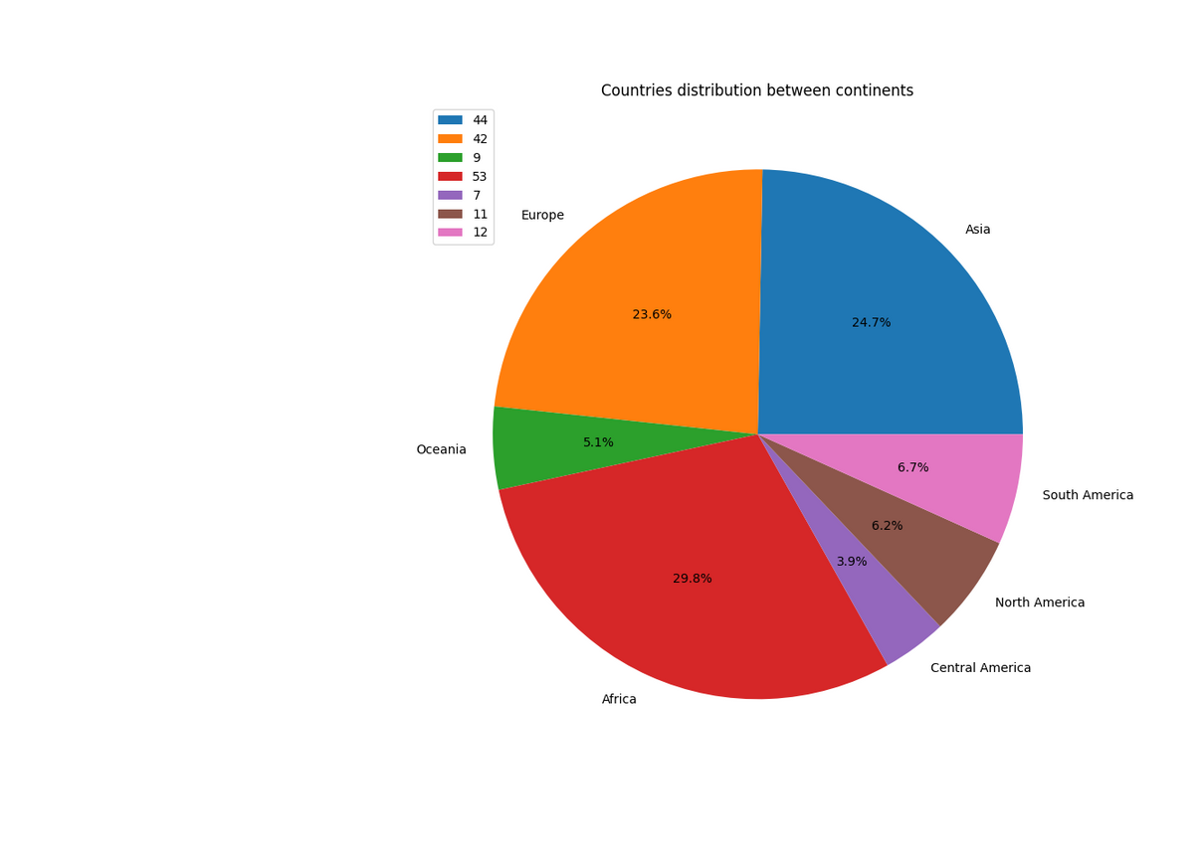
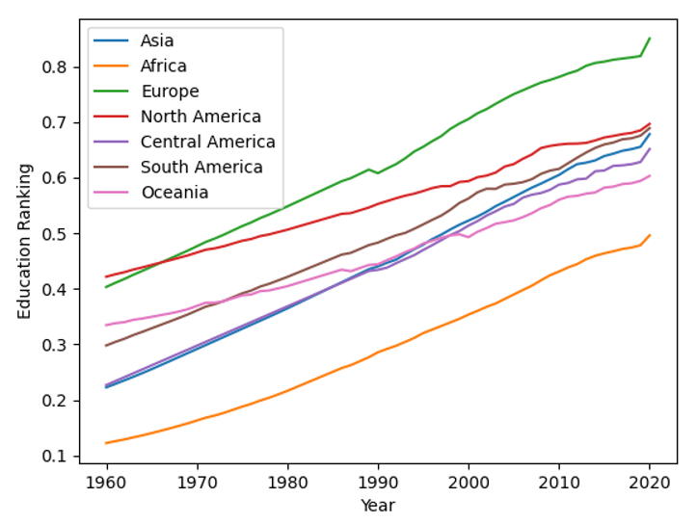
WHAT HAVE WE LEARNED FROM VIEWING OUR DATA?
Asia had a large increase and almost surpassed North America.
Overall, education improves as the years go by.
Africa has the most countries in the world

Slide 11
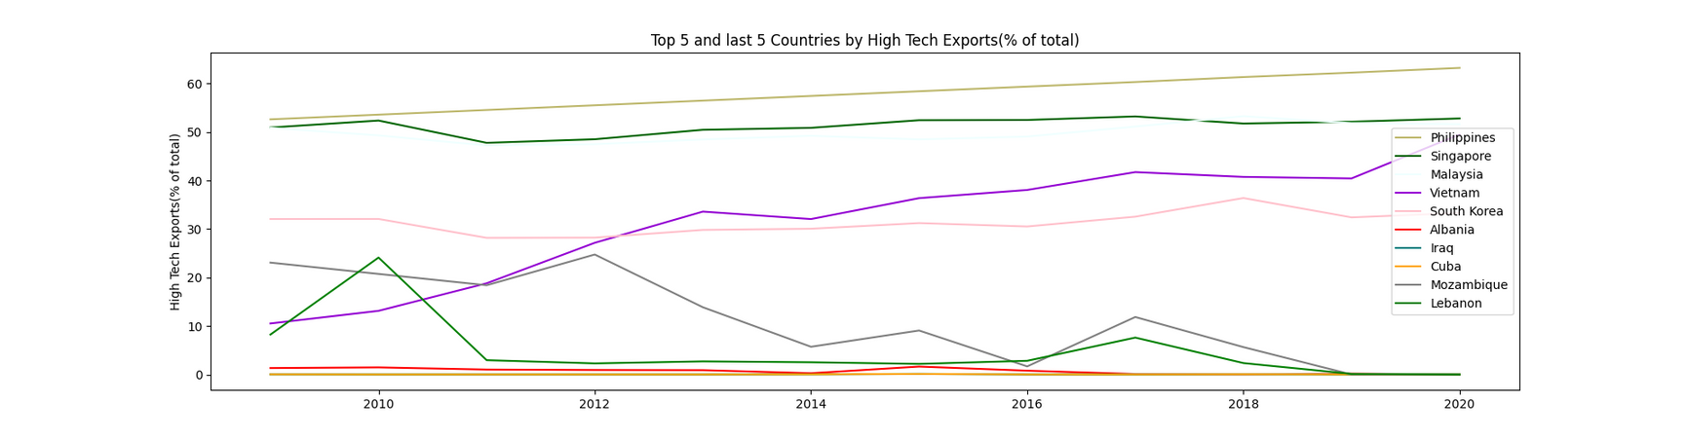
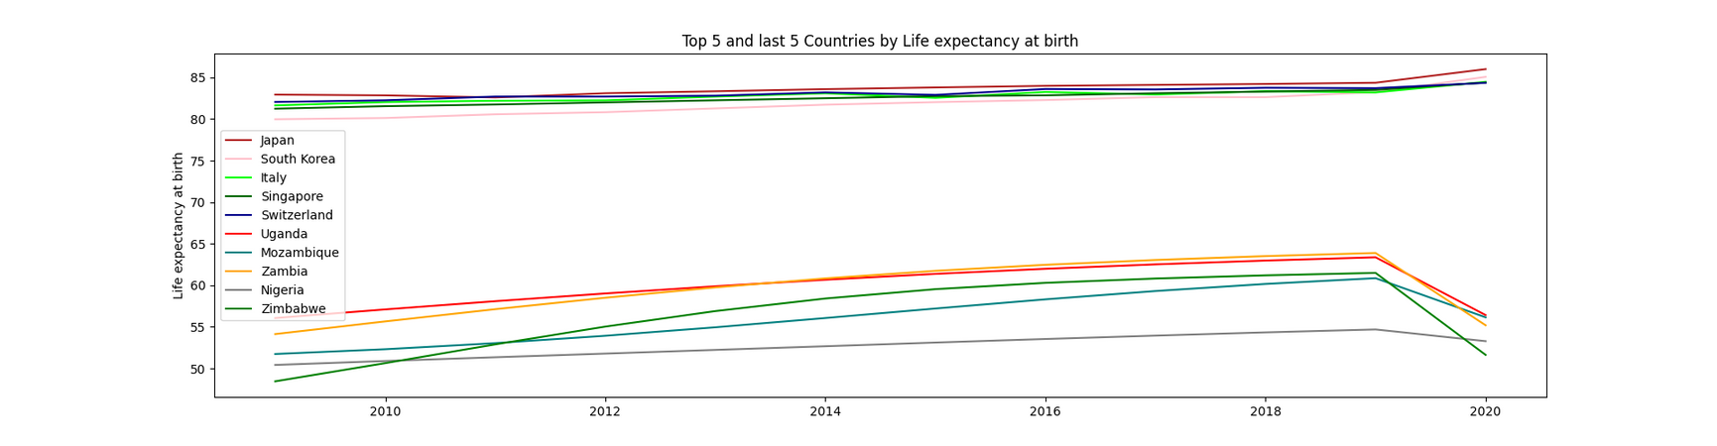
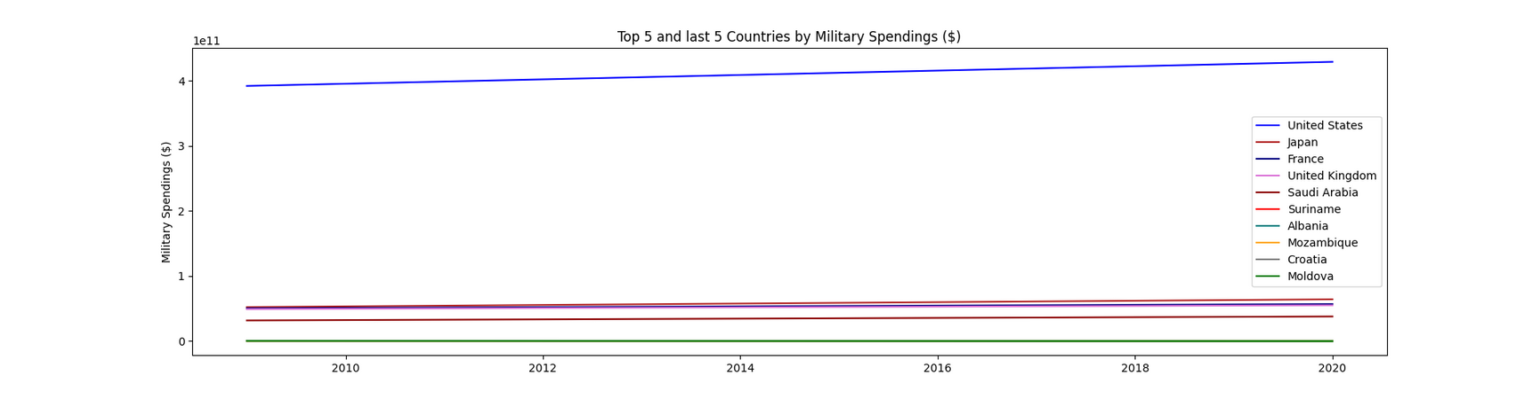
The Philippines’ biggest export products by value in 2020 were electronic circuits, computers, computer parts and accessories, insulated wire or cable and printing machinery.
Avg: 22.2%
Israel is above avg with: 28%
Life expectancy difference between Top 5 and Bottom 5 countries is more than 30 year!
Avg: 72.4 years
Europe with the highest: 78 years old
USA spent in 2020 429 Billions$ on military
4 times more the the next big spender: Japan

Slide 12
The Philippines’ biggest export products by value in 2020 were electronic circuits, computers, computer parts and accessories, insulated wire or cable and printing machinery.
Avg: 22.2%
Israel is above avg with: 28%
Life expectancy difference between Top 5 and Bottom 5 countries is more than 30 year!
Avg: 72.4 years
Europe with the highest: 78 years old
USA spent in 2020 429 Billions$ on military
4 times more the the next big spender: Japan

Slide 13
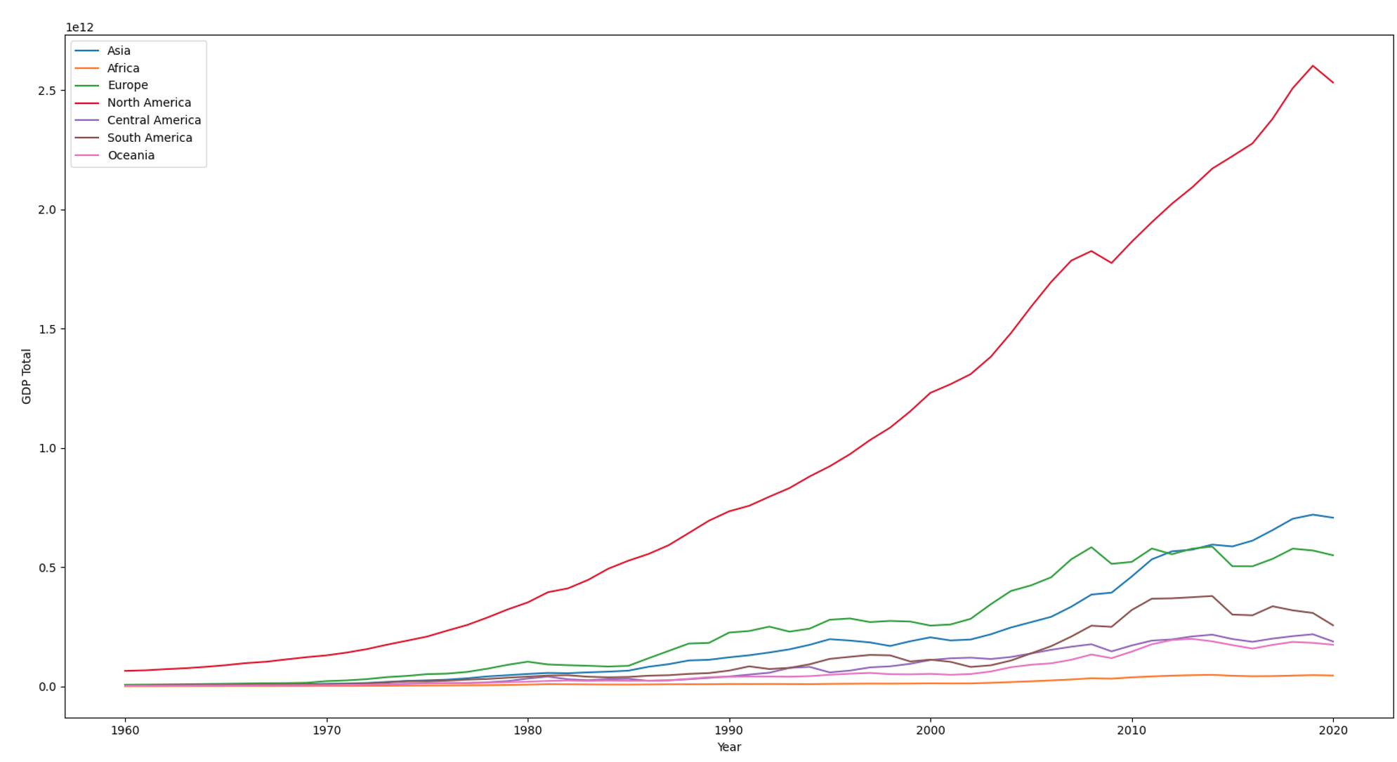
Total GDP per Continent
2008 Financial Crisis

Slide 14
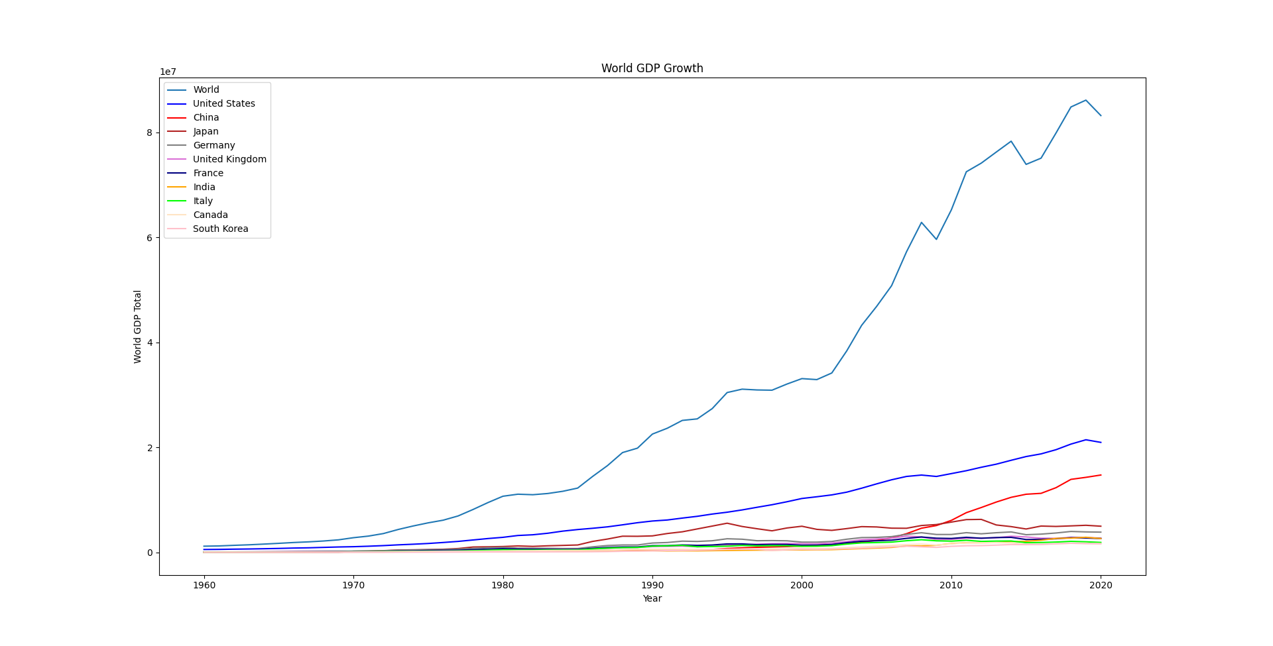
84 Billion$
2008 Financial Crisis
1.3 Billion$

Slide 15
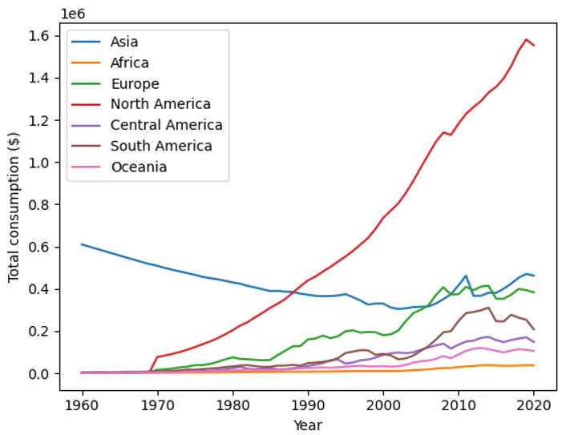
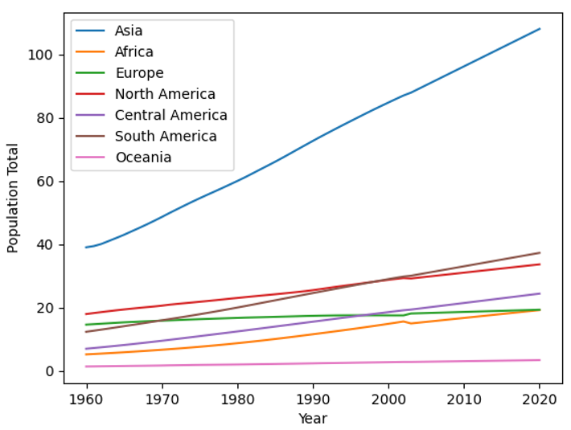
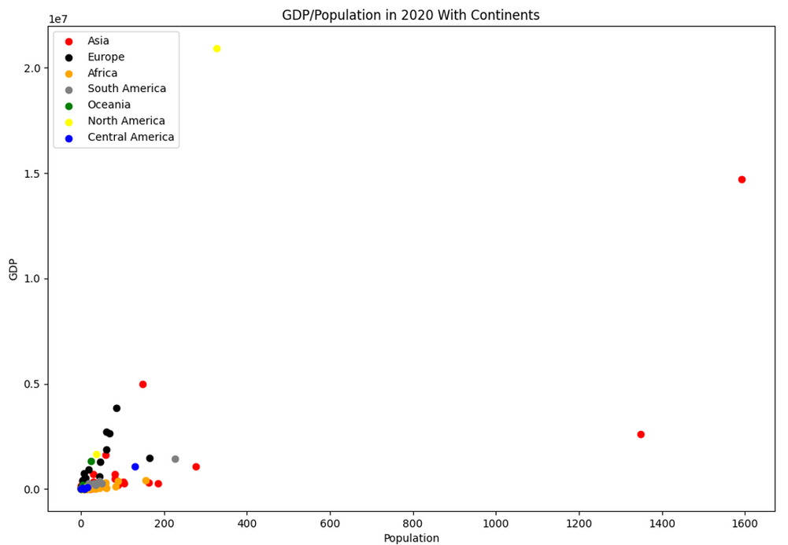

Asia's population growth is the largest by far
North America spends the most by far
USA
China
Rest of the world
India

Slide 16
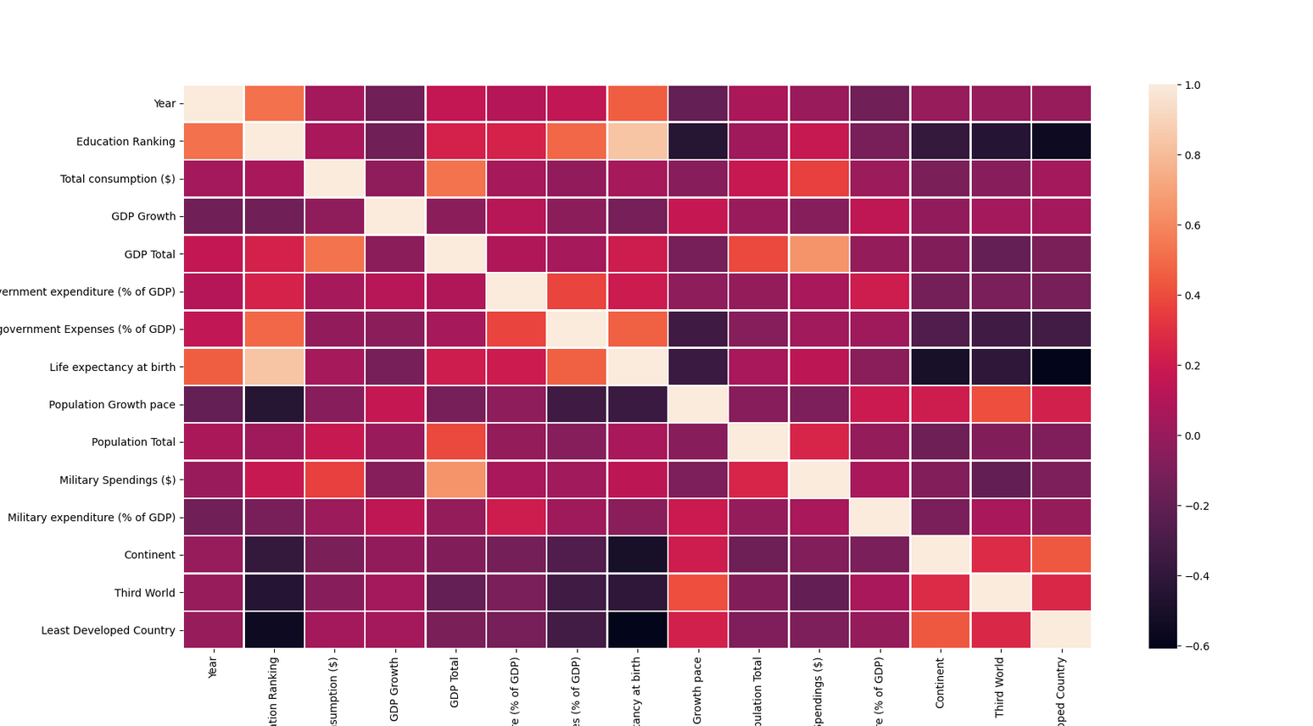
HEAT-MAP & CORRELATION SCORE
We took each Database's column and built a heatmap with correlation score.
Iterated on highest correlated columns.
Plot.
Saved the best.
Heatmap df_full_database

Slide 17
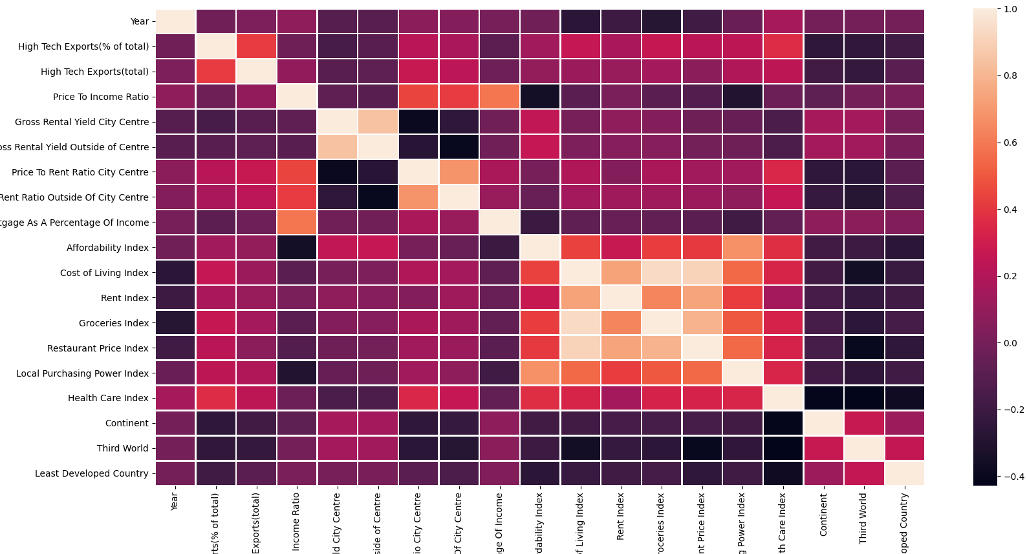
Heatmap df_scrape

Slide 18
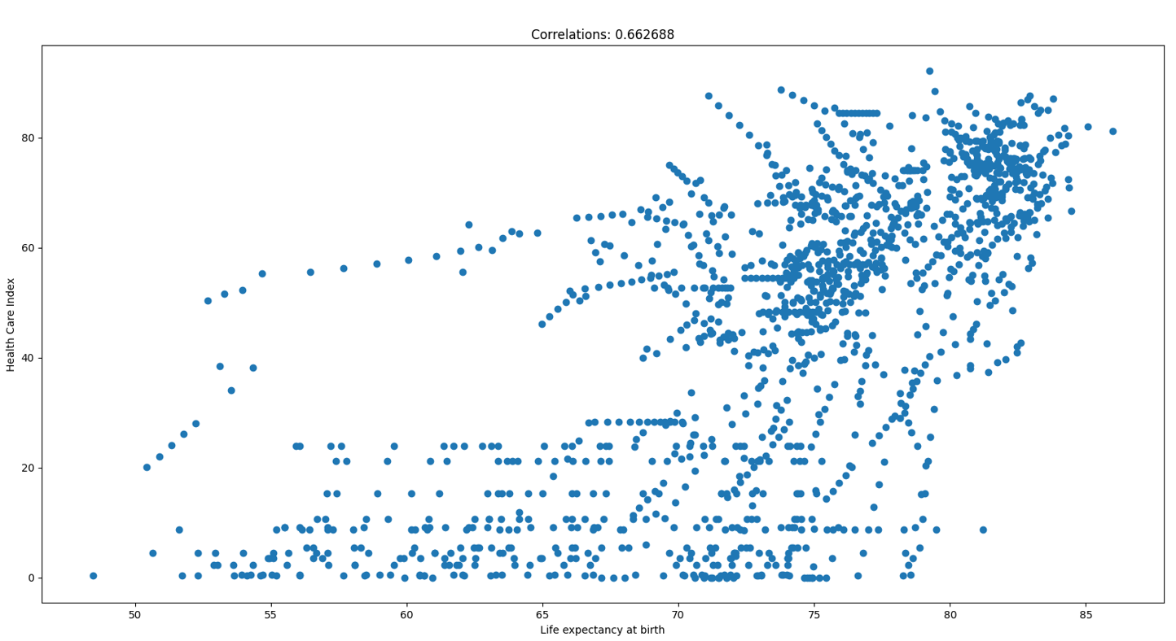
Countries with higher Healthcare index will likely result in high life expectancy among its residents.

Slide 19
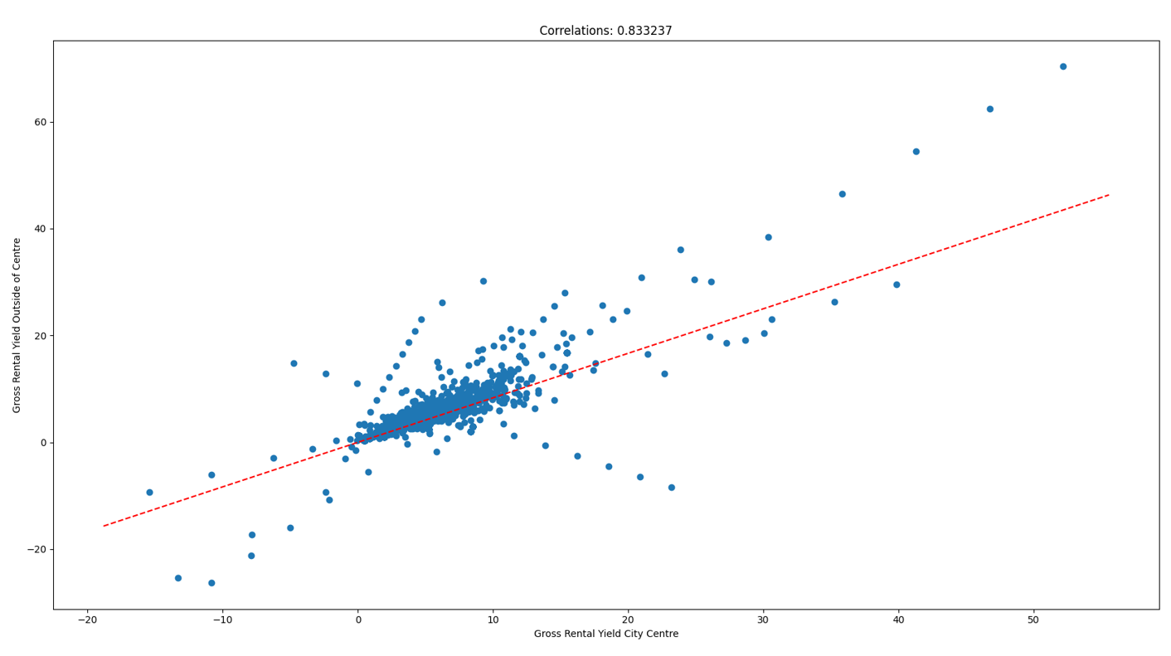
Rental prices increase in the city center will likely result in price increases outside the center too

Slide 20
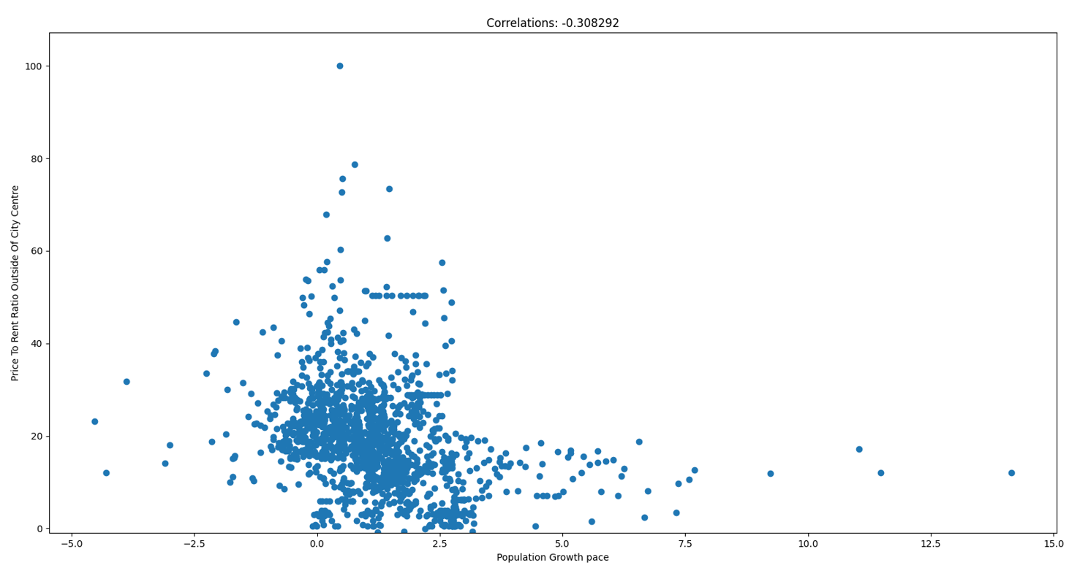

The population tends to increase, if people buy more houses outside of the city center

Slide 21
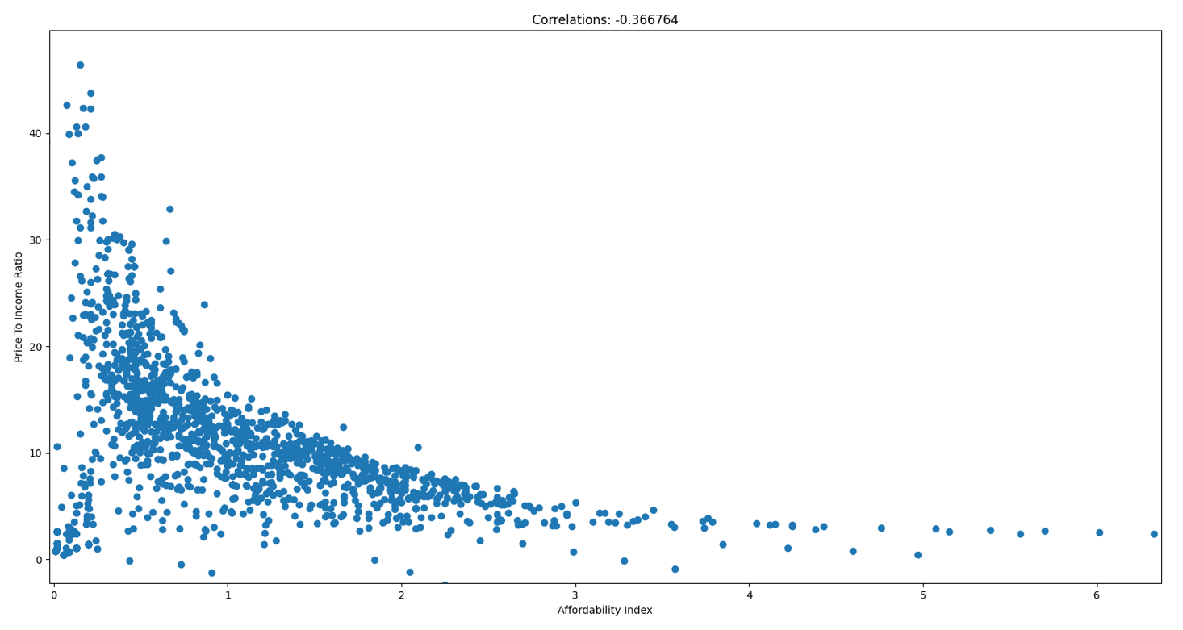
If you can't afford buying a house, you are more likely to rent a house and vise versa

Slide 22
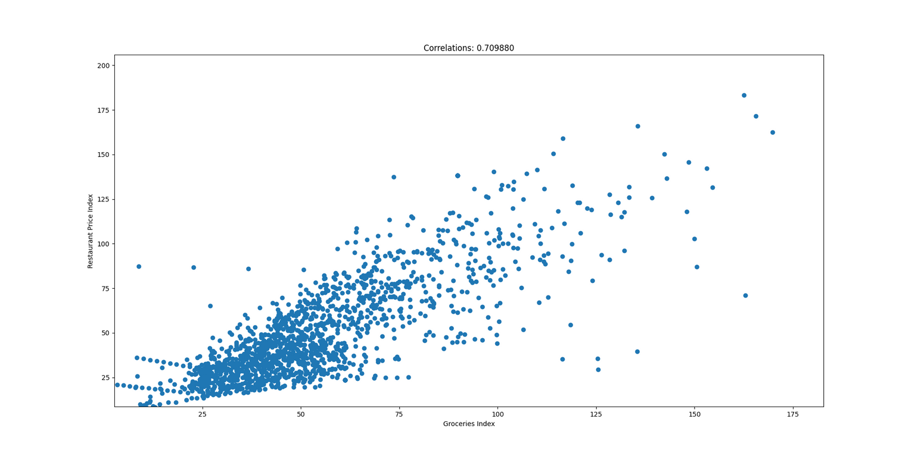
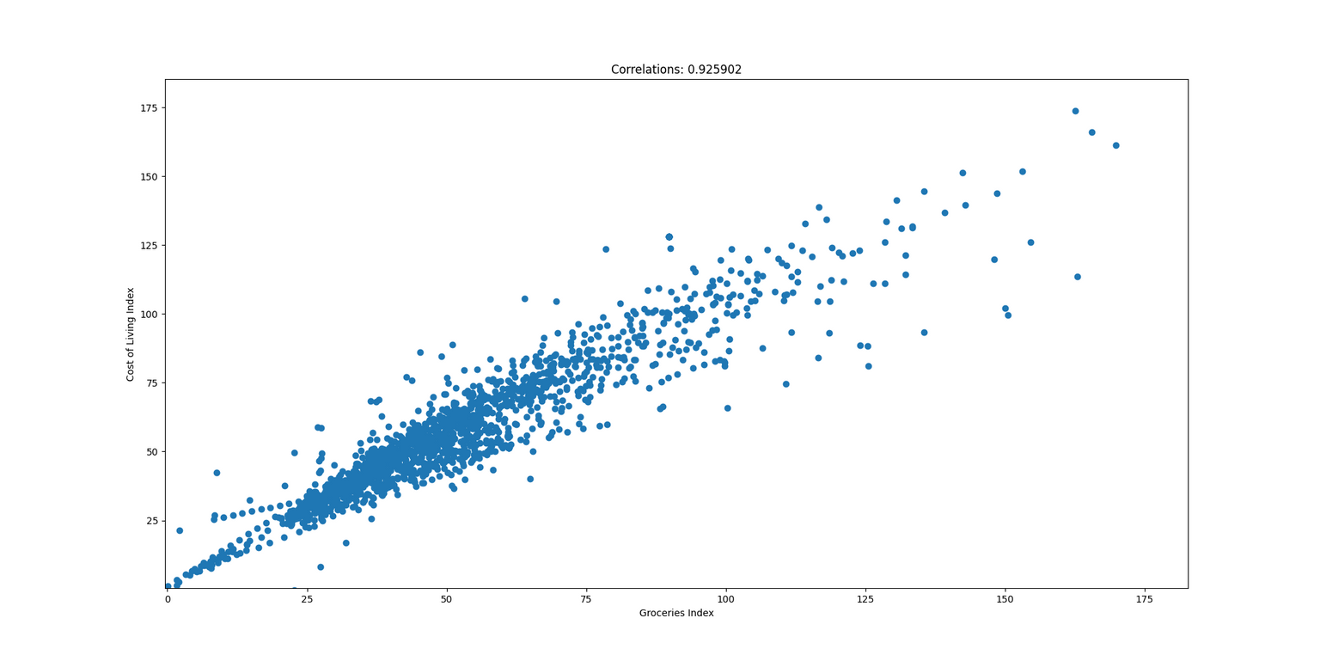
Restaurants prices and cost of living index tend to increase, correlating with the Groceries prices

Slide 24


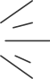
CHOOSING MODELS
We chose to use linear regression in order to predict the GDP of countries in 2030.
For clustering, we decided to use both KMeans and DBSCAN - to compare the results and choose the better model for us.
TRAINING & USING OUR LINEAR MODEL
We trained our model using the GDP data for each country from 1960 to 2020.
Using the trained model we predicted 2030's data.

Slide 25
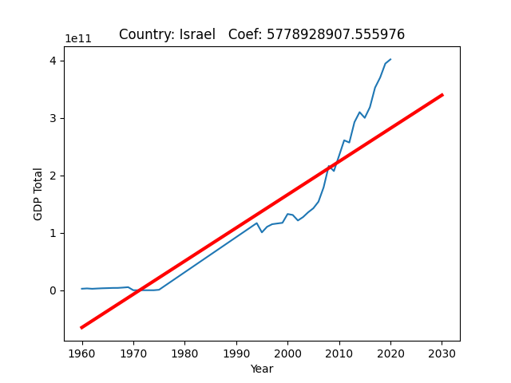
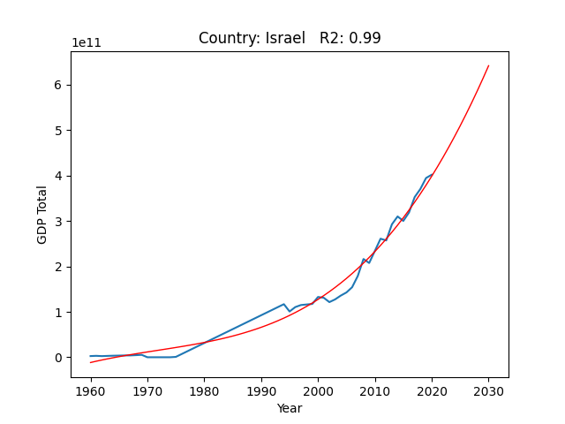


THE LINEAR REGRESSION MODEL
COMPARSION R2 SCORE
At first we've used linear regression, it was too Linear and not so accurate.
So we made a pipeline with Polynomial (degree 2-5) combined with linear regression for the prediction.
Here is the comparison:
 | World Wide Avg | Israel
Linear Regression | 0.7278 | 0.7543
Pipeline | 0.8363 | 0.9975
Subject
Model
LINEAR_REGRESSIOON
Country: Israel - R2_Score: 0.7543
PIPELINE
Country: Israel - R2_Score: 0.9975

Slide 26


THE CLUSTERING MODEL
KMEANS
We had too many columns so we decided to downgrade the dimension of the data using PCA.
We've done that so we could get 2D graphs.
FINDING HYPER-PARAMETERS AND MODEL SCORE
In KMeans and DBSCAN models, choosing the hyper-parameters is crucial for a successful model.
We've created functions for finding the best hyper-parameters for our models.
Afterwards we have determined the models performance using 'Silhouette score algorithm'.
Overall, the results vary, some graphs had better score with KMeans and some with DBSCAN.
DBSCAN
Comparison with graphs in slides 30-33

Slide 28
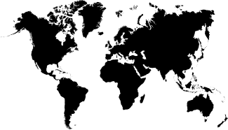




QUESTION 1
What can we learn from clustering countries?
Comparison between clustering methods (KMeans vs DBSCAN)
Who are the outliers?

Slide 29


HYPOTHESES
01
We expected to get 3 clusters:
A. Top Leaders (USA, China, Russia, etc.)
B. Average Countries.
C. Below Average.
02
Bordering countries will most likely be in the same cluster.
03
In DBSCAN - Top leaders and least developed countries will be considered as outliers.

Slide 30
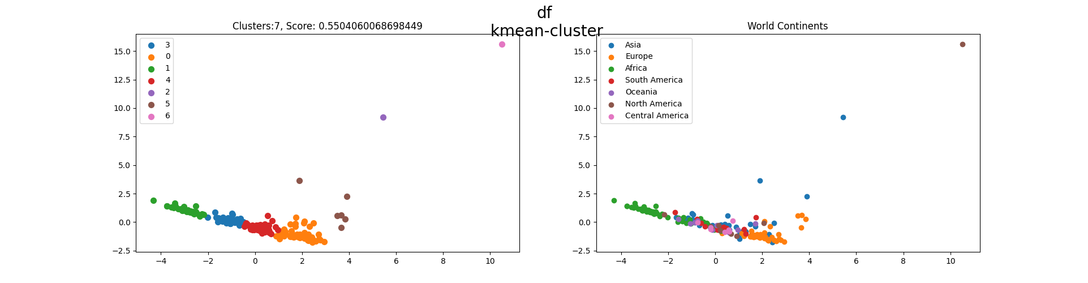
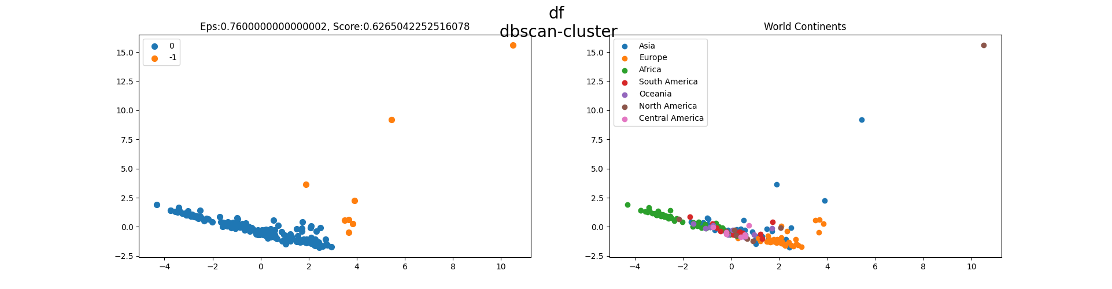
FULL DATA CLUSTERING
The lower graded clusters are mainly made out of African countries
The outliers are the top 7 GDP countries in 2020

Slide 31
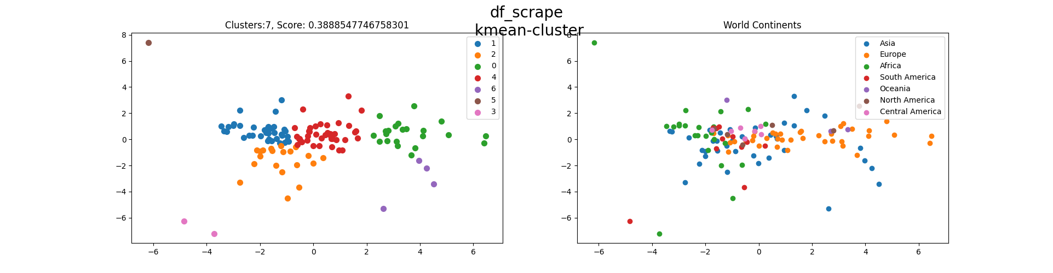
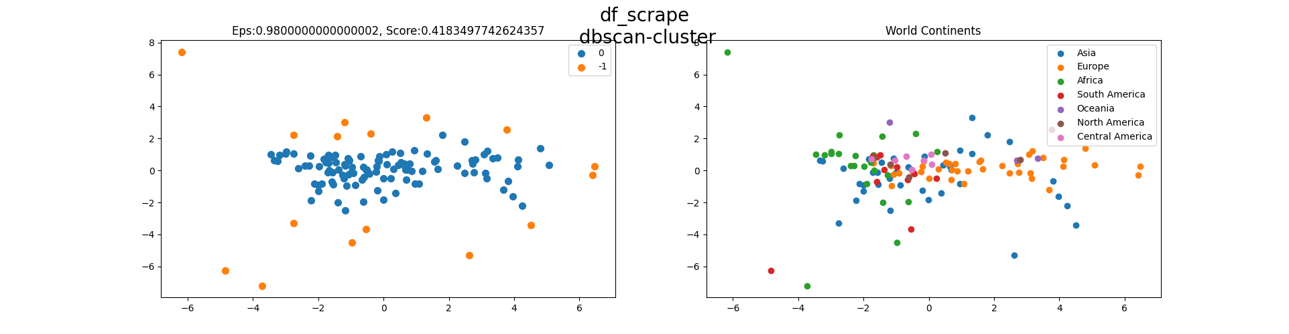
SCRAPED DATA CLUSTERING

Slide 32
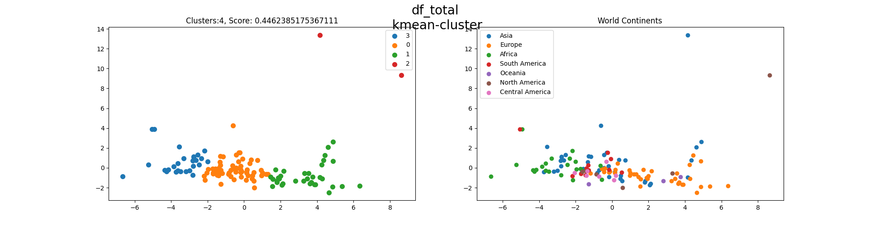
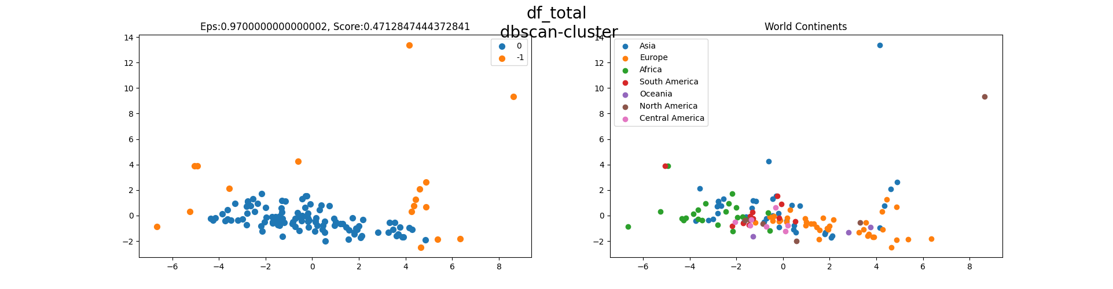
COMBINATION

Slide 33
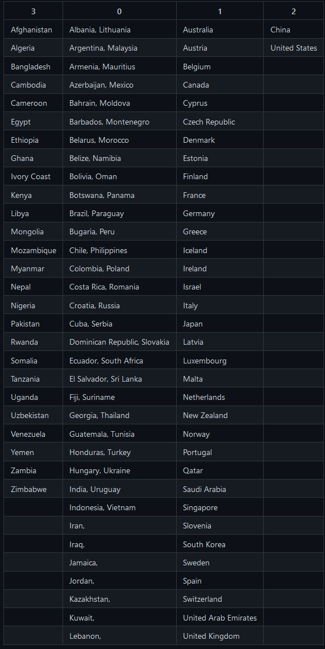
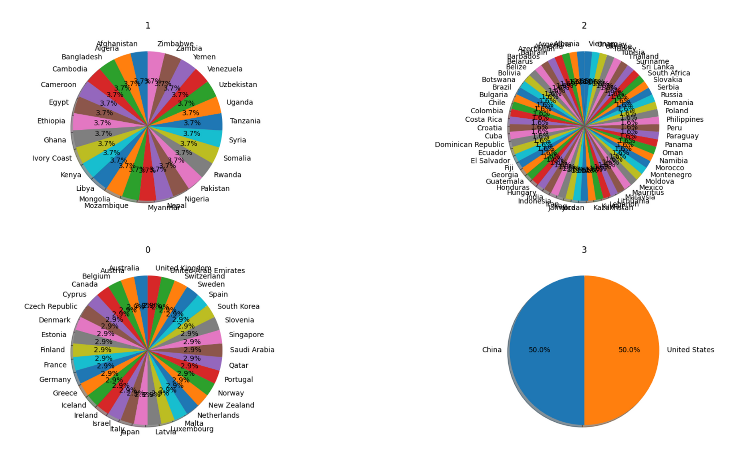





KMEANS CLUSTERING OF ALL DATA COMBINED
WITH THE COUNTRIES IN EACH CLUSTER
Way below Average Countries
Average Countries
Above Average Countries
World Biggest Leaders

Slide 34

CONCLUSIONS
01
After running the KMeans cluster algorithm we got more than 3 clusters as seen in the previous slide.
Bordering countries are likely to be in the same cluster.
Most African countries are in cluster 3.
Most European countries are in cluster 1.
Most American countries are in cluster 0.
02
03
After running the DBscan we were amazed to see that he clustered the outliers which some world leaders and some least developed countries.

Slide 35

QUESTION 2
How would the World GDP look like in 2030?
Who will be the world leading countries?
Will the current world leading countries keep their place in the future?
Comparison between 1960 & 2020.

Slide 36
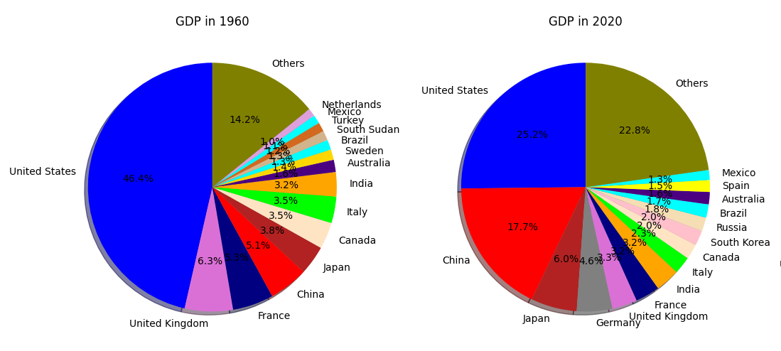
All other countries are getting stronger
Africa's GDP is still the lowest in terms of growth and total.
Top 4 countries in terms of growth:
1.South Korea: 41,093.82 %
2.China: 24,554.34 %
3.Japan: 11,129.35 %
4.United States: 3,753.60 %
Relatively China grew the quickest
by 340%

Slide 37
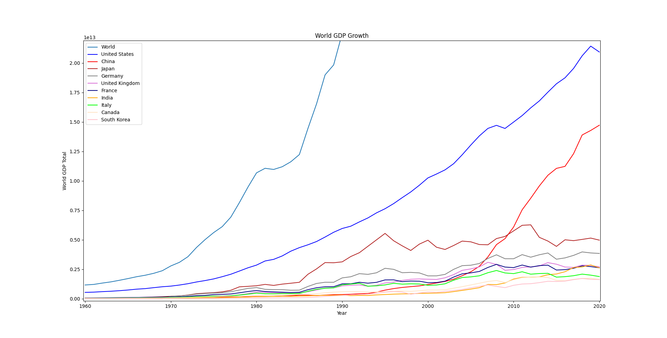
Slide 14 Zoomed in
China rises as a top leading country

Slide 38

HYPOTHESES
01
China will outgrow USA in the near future.
02
"Others" countries GDP will grow relatively to total GDP.
03
New countries will rise to the top.

Slide 39
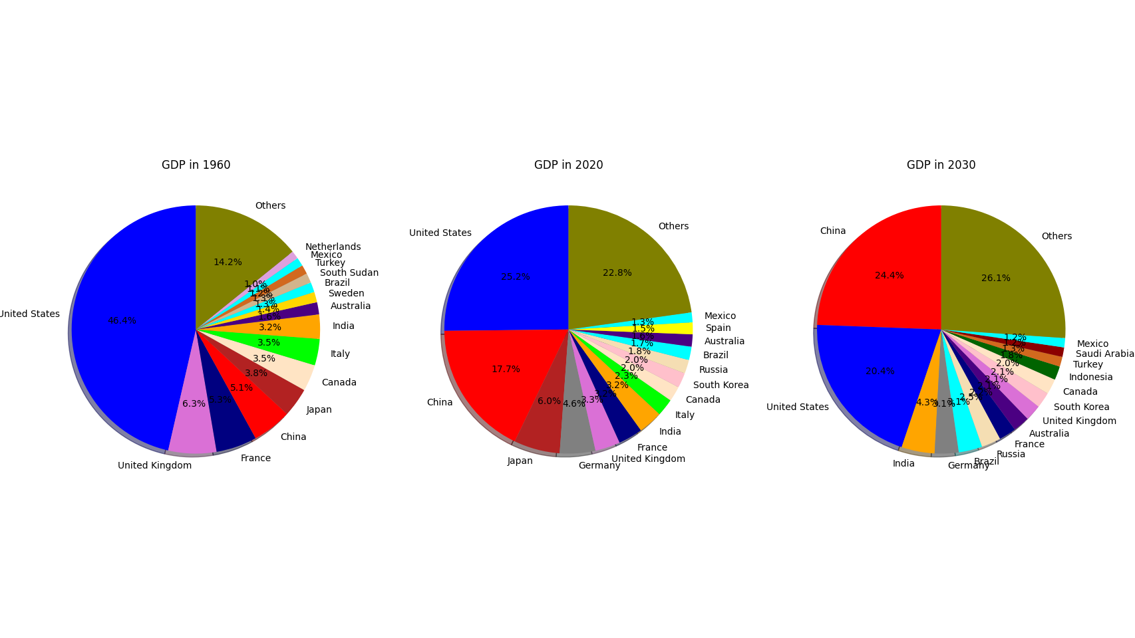
Comparision between years

Slide 40
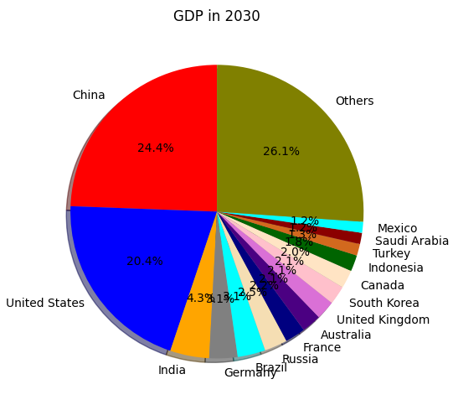
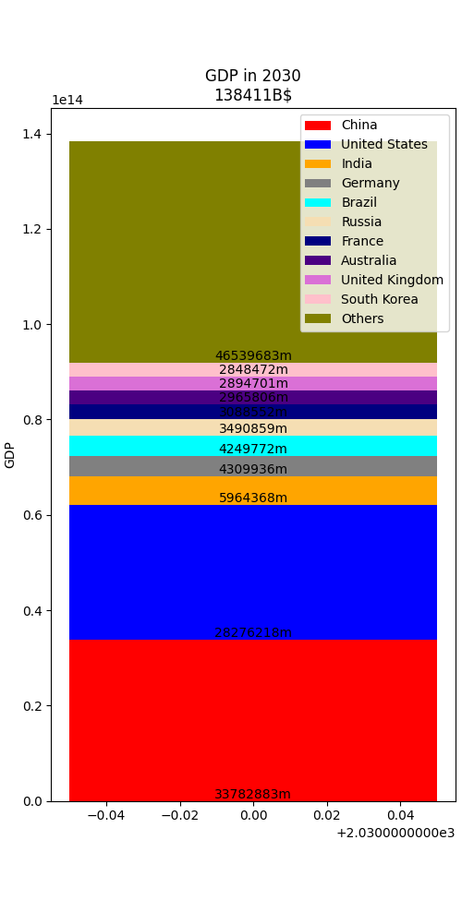
China grew from 5% to 24% in 70 years

Slide 41
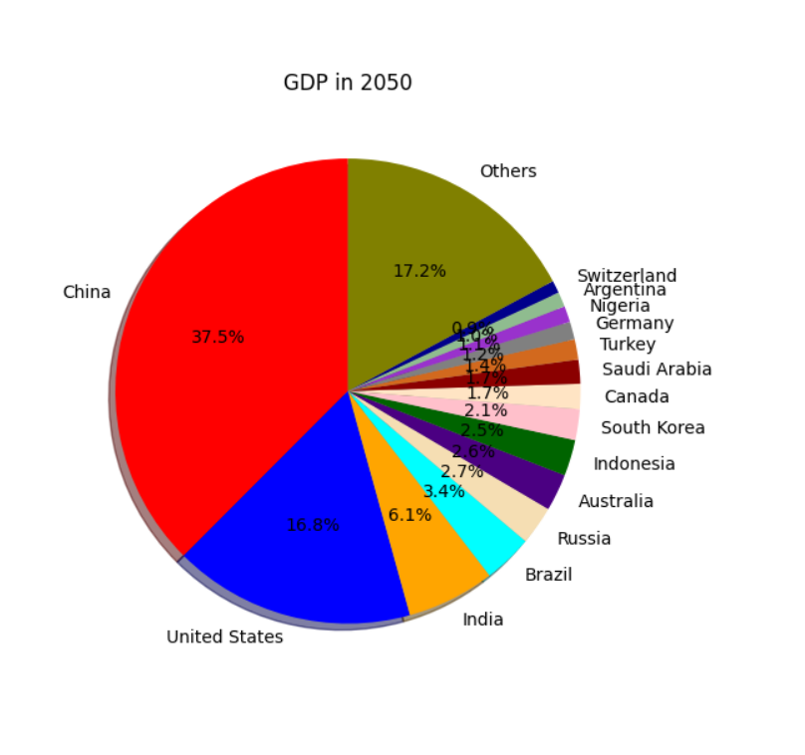
BONUS PREDICTION 2050
China outgrows USA by far.
India, Brazil and Russia are in the top 5.
Nigeria and Indonesia are in the top 15.

Slide 42

CONCLUSIONS
01
Based on the data, we predict that China will outgrow USA in the near future, to be precise - by year 2025.
China will be leading USA by 5,506,665m
02
Countries in the "Others" section GDP will grow relatively to the total GDP.
In 2020 they we're 22.8%
In 2030 they grew to 26.1%
03
New countries emerged to the top.
e.g Saudi Arabia, Indonesia, Turkey.

Slide 43



QUESTION 3
What can we learn from the data and graphs about history?
THE DATA EXPLAINS OUR HISTORY
Throughout history, humans killed each other while trying to gain control and power.
This fact, is represented in our data and reveals "dark history" for some.

Slide 44
HYPOTHESES
01
Significant events will stand out in the graphs.
02
Least developed/Smaller countries are more sensitive to historical events.
03
Revolution / Collapsion can impact the country's GDP.

Slide 45





GENOCIDE, WARS & USSR LISTS
Genocide & Wars
USSR Countries
Based on the outliers and inconsistent data in the graphs we've concluded those countries have been through war/s, Civil war/s and genocide.
The fall of Soviet Union affected many countries especially Russia.
* Afghanistan
* Angola
* Bangladesh
* Bosnia and Herzegovina
* Cambodia
* Democratic Republic of the Congo
* Eritrea
* Ethiopia
* Guatemala
* Iraq
* Lebanon
* Myanmar
* Nigeria
* Sierra Leone
* Sudan
* Timor-Leste
* Uganda
* Vietnam
* Yemen
* Armenia
* Azerbaijan
* Belarus
* Estonia
* Georgia
* Kazakhstan
* Kyrgyzstan
* Latvia
* Lithuania
* Moldova
* Russia
* Tajikistan
* Turkmenistan
* Ukraine
* Uzbekistan

Slide 46
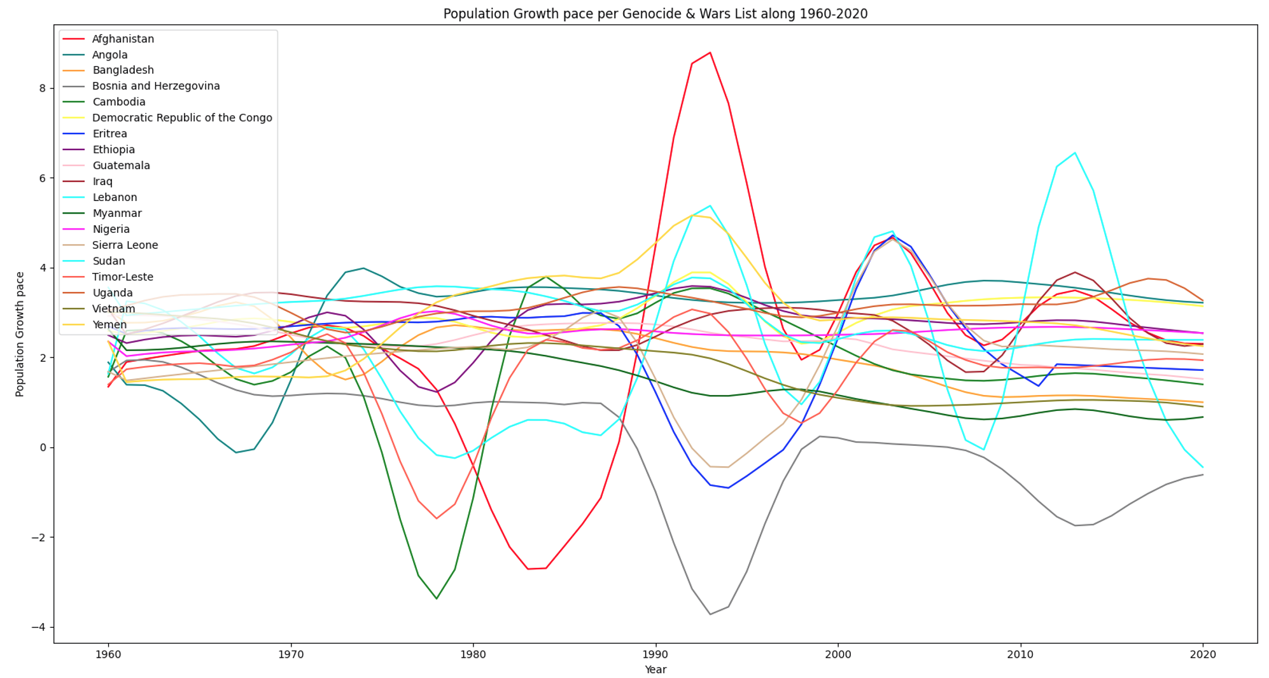
Lebanese Civil War
Lebanon Conflict
Lebanon Clashes + Syria civil war spillover in Lebanon
Afghanistan Civil War
Timor-Leste Crisis
Angola
Colonial War
Timor Leste Genocide
Bosnian Genocide
Eritrean–Ethiopian War
Lebanon Second War
Sierra Leone Civil War
Cambodian Genocide
Soviet-Afghan War

Slide 47
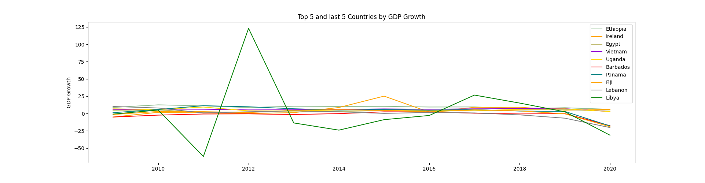
Muammar Gaddafi Libya Overtake 2010
Growth of 165% in 1 year.
The people overtook corrupted leader Gaddafi

Slide 48
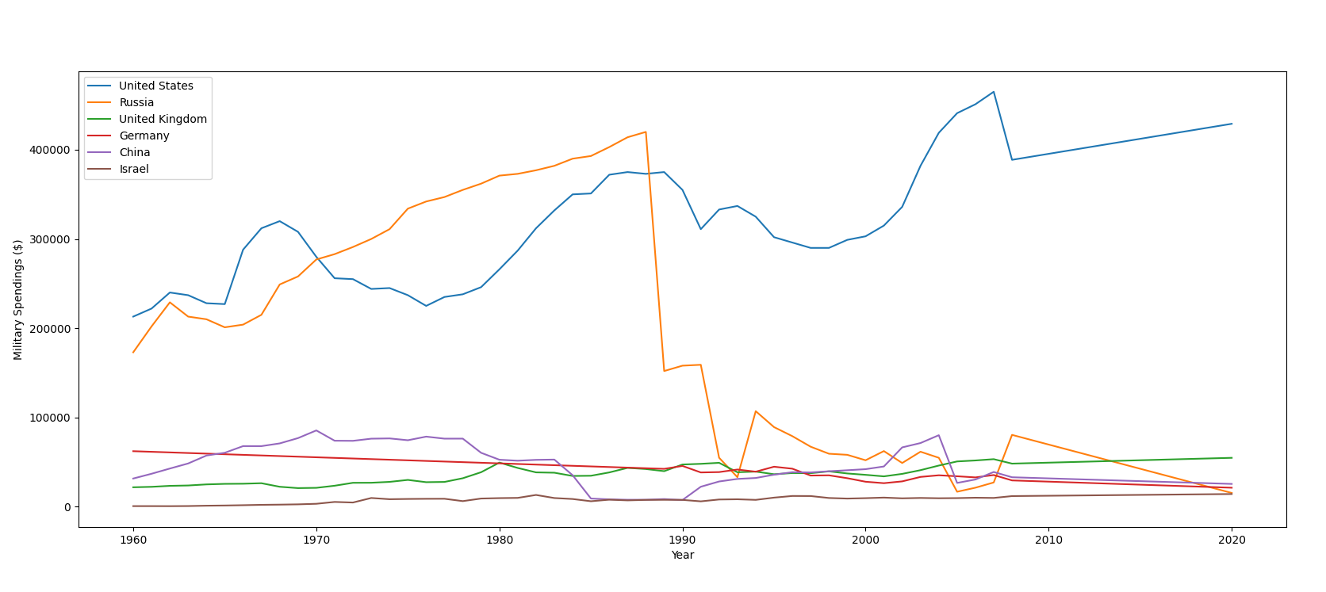
USA 9/11 & Vietnam War
9/11
Vietnam War

Slide 49
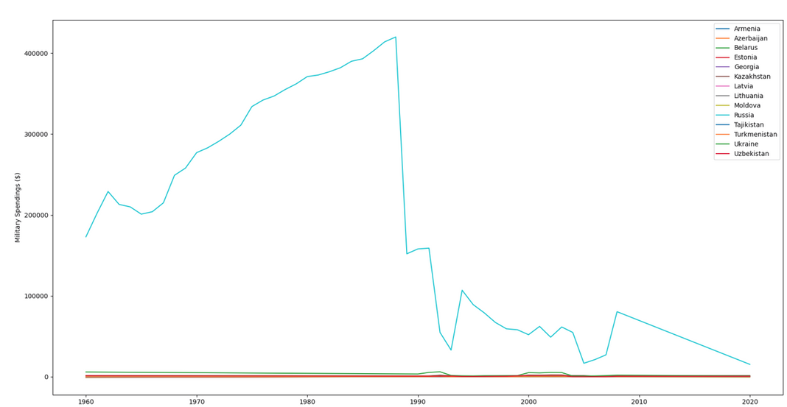


USSR Military Spending's
USSR collapsed in 1991,
we can see the effect on the Union members in the following graphs.
Effect on the population
Effect on the GDP
Russia was affected the most regarding military spending's.
USSR Fall
USSR Population Drop
USSR Total GDP
Zero Line
USSR Fall
USSR Fall

Slide 50

Israel Military Spending
In the first early years of Israel, they been through many wars, which meant a large percent of the GDP went towards military expenditures.
Yom Kippur war
The Gulf war
Six Day war

Slide 51

Bonus Data: Population growth ISR
1961 Marrocan Migration
1990 USSR Migration

Slide 52
CONCLUSIONS
01
Most significant events do stand out in the graphs, and tell about the rise and fall of countries in term of finance and population.
02
Sadly, least developed/smaller countries are more sensitive to changes.
As shown in the graphs, this is highly accurate when talking about
Africa and Asia.
We've discovered many wars and genocides that are less familiar.
03
We've seen that revolution / collapsion does in fact impact a country's GDP.
i.e USSR collapse, Lybia post Muammar Gaddafi

Slide 53
E.T.Z Predictions
Thanks for
Watching
Any Questions?

